Slide 1
Gesture Controlled Mouse Pointer
Team Tripling
Guide: Ms. S. Deepanjali
Ayush Roy (RA1611008010641) Saumya Awasthi (RA1611008010414) Ansh Vinod Motwani (RA1611008010661)

Slide 2
Introduction and Objective
PC innovation has massively grown over the previous decade and has turned into a vital piece of ordinary life. The essential PC hardware for Human Computer Interaction (HCI) is the mouse. The mouse isn't appropriate for HCI in some genuine circumstances, for example, with Human Robot Interaction (HRI). Most workstations today are outfitted with webcams, which have as of late been utilized instability applications using face acknowledgment. So as to tackle the maximum capacity of a webcam, it tends to be utilized for vision-based CC, which would adequately dispose of the requirement for a PC mouse or mouse cushion. Our project deals with controlling the mouse pointer and carrying out the functions of a trackpad with the help of hand gestures. Moving our hand would allow us to change tabs, double click an item, drag objects and carry out other simple tasks.

Slide 3
Existing System and Issues in Existing System
The existing cursor control techniques are becoming obsolete over time. Using the mouse in small spaces like car seats or while travelling by flights becomes very tedious. Touchscreens confine the user to a very limited working space and the user must always be present in very close proximity of the computer. Therefore we need to come up with a solution which can be feasible in all situations and it is economically viable.
Issues in existing technology
Use of external webcam
Use of colour strips
Inaccuracy due to improper lighting
Problems caused due to unwanted objects in the background

Slide 4
System Architecture
Capture the real time video.
Extract individual frames.
Flip the frame.
Apply Machine Learning to identify different fingers
Perform various functions.
Track the pointer
Find the center point

Slide 5
System Workflow
The system workflow can be broadly explained in the following steps.
Dataset Gathering
Pre-processing Dataset
Model Training using Neural Network

Slide 6
System Workflow
Dataset Gathering
To train the system, a dataset is required comprising of testing and training data. The dataset used in this project is self-generated. The testing dataset comprises of 6 sets of 1000 images each in which each set denotes a different gesture. The training data comprises of 6 sets of 100 images each in which each set denotes a different gesture. For capturing the data, the camera clicks the image in a loop depending on which type of image it is. Every image gets automatically numbered based on the iteration value.

Slide 7
System Workflow
Preprocessing Dataset
Once the dataset is generated, all the images must be resized to a fixed size for all the computations to take place. Same sized images are required for all the computations to take place. It eases the computation process if the size of the images is known. Every image is converted to 100 x 89 pixels and the previous image is overwritten with the new resized image.

Slide 8
System Workflow
Model Training using Machine Learning
In Machine Learning, Deep Neural Networks (DNN) is a supervised learning algorithm where the machine recurrently performs the same task on every element of the sequence of where the output of each task is dependent on every previous calculation. This method learns in a sequence called feature hierarchy. Where the features on the top of the hierarchy are computed by the help of features at the bottom of the hierarchy.

Slide 9
Module Split
The modules could be broadly split into the following parts.
Capture the real time video.
Extract the individual frames.
Resize the frame.
Flip the frames.
Get the ROI (Region of Interest).
Convert the ROI to grayscale.
Eliminate the background.
Predict the gesture.
Draw the contours and calculate the center point.
Track pointer according to the centroid movement.
Perform different actions with the different contours extracted.

Slide 10
Capturing the real time video
For the system to sense the movement of hand we need a sensor. We used the web camera in our work for that sensing. The web camera captures the real time video that is it gives us the real time news feed. The captured image is at a particular resolution and at a particular frame rate. We can change the frame rate and resolution according to our needs. The web camera captures the real time video. This is divided into different frames. These frames are then processed further.
Extract the individual frames
In this step, we extract every frame captured by the camera. Since the camera takes the input in the form of a video, we need to convert that video into multiple individual frames. This is necessary because all the computations are done on individual frames and not on the entire video. Once every frame is extracted, the images can be processed.

Slide 11
Resizing the image
When the camera captures the real time feed and converts it into the frames then the frame obtained might be of different size. So, we need to resize the image to fit our need. Now this image is inverted. It is like the image we get when we stand in front of the mirror. So, if we move our coloured strip to right it will in turn move to left and so will our mouse pointer. This will create a lot of confusion in operating the mouse pointer. Hence, we need to flip each frame. This is done by vertically inverting the frame.
Flipping the Image
Now this image is inverted. It is like the image we get when we stand in front of the mirror. So, if we move our coloured strip to right it will in turn move to left and so will our mouse pointer. This will create a lot of confusion in operating the mouse pointer. Hence, we need to flip each frame. This is done by vertically inverting the frame.

Slide 12
Getting the Region of Interest
The Region of Interest is a small part of the entire frame which is the actual area where all the processing will be done. The remaining part of the frame is ignored. Only the image inside this region is processed. This is done to remove any unnecessary objects in the background which can cause noise.
Convert the Region of Interest to grayscale
The image is converted from an RGB image into a grayscale image so that the foreground and background images can be properly differentiated. This helps in easier computation as there is a clear distinction between the hand and the background. This also helps to remove any noise from the image.

Slide 13
Eliminate the Background
In this step, all the background images are removed and only the image of the hand is shown. This is important as based on this image, the different gestures made by the hand will be predicted. The hand is shown in white colour and the remaining background is shown as black colour.
Predict the gesture
The image then passes through our convolutional neural network. The gesture is predicted on basis of how the neural network is trained previously. This is an important step as a major part of the accuracy of our system depends on it.

Slide 14
Draw the contours and its centroid
The contours are drawn around the hand gesture. Contour is the outer line around a certain area. After this we calculate the centroid. It is the center point of the area surrounded by the contour. We control our mouse pointer movement with respect to the calculated centroid.
Tracking and performing different functions
The tracking and different actions performed are done using the inbuilt library in python named PyAutoGUI. This library has many functions for left click, right click or just moving the pointer and many more.

Slide 15
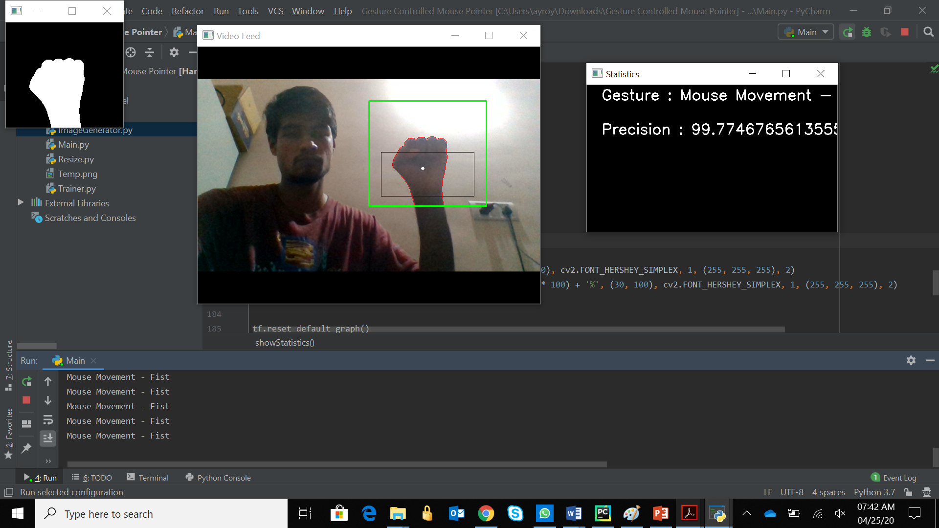
Implementation Procedure
The program runs when the Main.py file is run. It opens three separate windows which help in the execution of the program.

Slide 16
Implementation Procedure
The tracking and different actions performed are done using the inbuilt library in python named PyAutoGUI. This library has many functions for left click, right click or just moving the pointer and many more.
The following are the different functions which are performed
Mouse Movement
Left Click
Right Click
Double Click
Scroll Up
Scroll Down

Slide 17
Tools Used
The tools used to execute the code are as follows.
Pycharm IDE
Python 3.0
OpenCV Library
PyAutoGUI Library

Slide 18
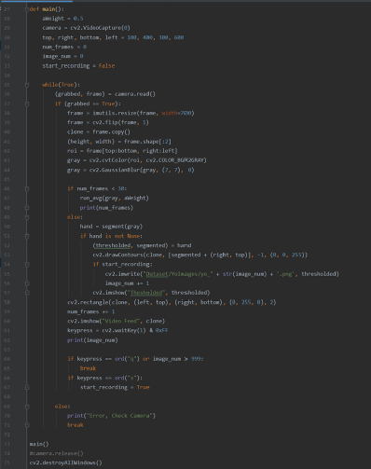
Code Snippets
Code for Convolutional Neural Network
Code for dataset generation
Code for resizing images

Slide 19
Output
Mouse Movement Gesture
Left Click Gesture

Slide 20
Output
Right Click Gesture
Double Click Gesture

Slide 21
Output
Scroll Up Gesture
Scroll Down Gesture

Slide 22
Conclusion
We have developed a hand gesture-controlled mouse pointer by using web camera. We have used OpenCV and Tensorflow software to implement our project. Along with OpenCV we coded in Python language, we used convolutional neural network to recognize different gestures and we have used PyAutoGUI, an inbuilt library in python to programmatically control the mouse and keyboard. This technology has great applications in the fields of computer graphics, gaming, prosthetics, and many more. This technology can be used to help patients who are physically challenged. Most of the earlier applications developed required additional hardware which is often very costly. Our aim was to create this technology in the cheapest all possible way and to create it on a standardized operating system. Various application can be developed using this technology with the minimum requirement of resources.

